Slide 1
Unit 2 Data Preprocessing
Handling Missing Data
Lecture 3

Slide 2
Identifying and handing missing data
Missing Data
Missing data refers to the absence of certain values in the dataset.
Missing data is a common challenge in data science, affecting analysis accuracy and statistical power.
Missing data, or missing values, occur when you don’t have data stored for certain variables or participants.
Data can go missing due to incomplete data entry, equipment malfunctions, lost files, and many other reasons.
In any dataset, there are usually some missing data. In quantitative research, missing values appear as blank cells in your spreadsheet of csv file.

Slide 3
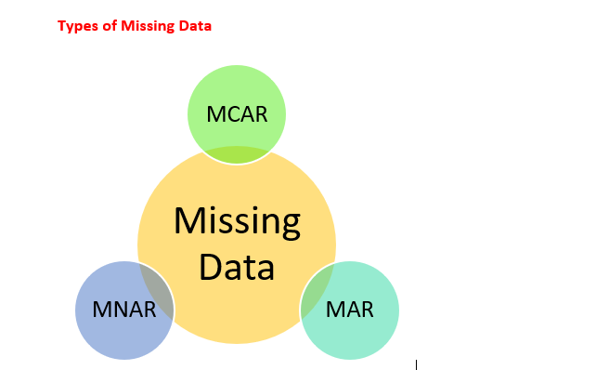
Consequences of Missing Data
Result can be biased
Incorrect accuracy and precision
A substantial loss in power
MCAR: Missing Completely at Random
MNAR: Missing Not at Random
MAR: Missing at Random

Slide 4
a) Missing Completely at Random (MCAR)
MCAR means that the missing data is entirely unrelated to any values (observed or unobserved) in the dataset.
In other words, the missingness has no pattern or reason — it’s purely random.
For e.g., you conduct a survey where people fill out their age and height.
If some people randomly forget to answer the height question (and there's no link between the person's age or any other factor and their likelihood of skipping the height question), then this missing data can be considered MCAR.

Slide 5
import pandas as pd
import numpy as np
# Create a sample dataset
data_mcar = pd.DataFrame({
'Age': [25, 30, 35, 40, 45, 50],
'Height': [160, 175, 180, np.nan, 165, 170] # Randomly missing value in 'Height'
})
# Display the dataset
print("MCAR Example Dataset:")
print(data_mcar)

Slide 6
b) Missing at Random (MAR)
MAR means that the missingness in data is related to some other observed information in the dataset, but not the missing values themselves.
Consider a survey where people are asked about their age and income.
If younger people are more likely to skip the income question, then the missingness of income data depends on age.
This is MAR because we know the missingness is related to another observed variable (age), but not to income itself.

Slide 7
import pandas as pd
import numpy as np
# Create a sample dataset
data_mar = pd.DataFrame({
'Age': [20, 22, 25, 28, 30, 35, 40],
'Income': [np.nan, np.nan, 40000, 42000, 50000, 60000, 65000]
})
# Display the dataset
print("\nMAR Example Dataset:")
print(data_mar)

Slide 8
c) Missing Not at Random (MNAR)
MNAR means that the missing data depends on the value of the missing data itself.
Let’s say you are conducting a survey on people’s age and income, but some people choose not to answer the income question. The likelihood that a person skips the income question is directly related to their income — for example, wealthier people may be less likely to disclose their income.

Slide 9
import pandas as pd
import numpy as np
# Create a sample dataset
data_mnar = pd.DataFrame({
'Age': [25, 30, 35, 40, 45, 50, 55]
'Income': [35000, np.nan, 40000, np.nan, 45000, 50000, np.nan]
})
# Display the dataset
print("\nMNAR Example Dataset:")
print(data_mnar)

Slide 10
Identifying Missing Data
Identifying missing data is an essential first step in data cleaning.
common methods to detect missing values in Python are:
Using isna() or isnull()
Using info()
Using notna()
Using any() and sum() with isna()
Using visualization techniques

Slide 11
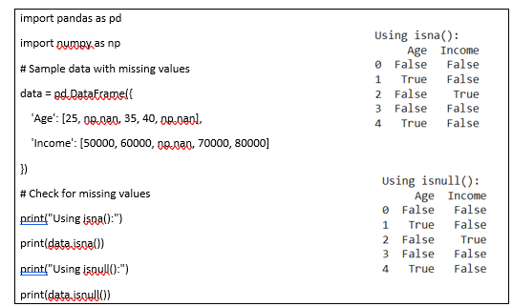
i) Using isna() or isnull()
The isna() and isnull() fucntions in Pandas detect NaN values.
They return True for missing values and False for present values.

Slide 12
Task:
Use Titanic data sets from kaggle for checking missing values using :
//isna or isnull

Slide 13
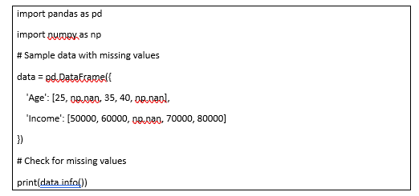
ii) Using info()
The info() function in Pandas provides a quick summary of the dataset, including the count of non-null values per column.

Slide 14
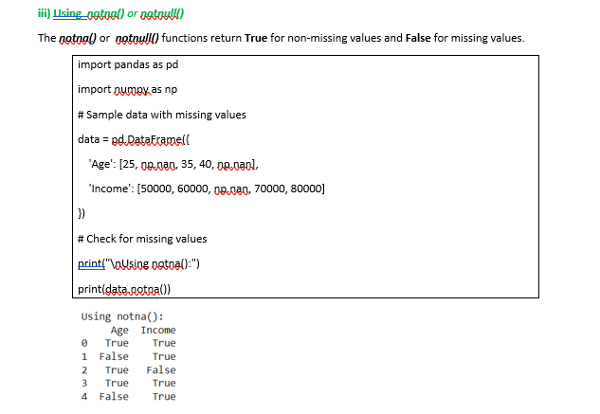

Slide 15
iv) Using any() or sum() with isna()
To quickly check if any column contains missing values, we can use any() or sum() with isna()
import pandas as pd
import numpy as np
# Sample data with missing values
data = pd.DataFrame({
'Age': [25, np.nan, 35, 40, np.nan],
'Income': [50000, 60000, np.nan, 70000, 80000]
})
# Check if any value is missing in each column
print("\nAny missing values in each column?")
print(data.isna().any())
# Count the number of missing values per column
print("\nCount of missing values in each column:")
print(data.isna().sum())

Slide 16
Using Virtualizations Techniques
import pandas as pd
import numpy as np
import missingno as msno
import matplotlib.pyplot as plt
# Sample data with mising values
data = pd.DataFrame({
'Age': [25, np.nan, 35, 40, np.nan],
'Income': [50000, 60000, np.nan, 70000, 80000],
'Gender': ['Male', 'Female', 'Male', 'Female', np.nan]
})

Slide 17
# Create a figure and axis with a smaller size
fig, ax = plt.subplots(figsize=(5, 4)) # Smaller figure size (5, 4 inches)
# Plot the missing data matrix on the axis
msno.matrix(data, ax=ax)
# Add title and labels
plt.title('Missing Data Matrix')
plt.xlabel('Columns')
plt.ylabel('Rows')
# Show the plot
plt.show()

Slide 18
Handling Missing Data
Filtering out data or filling missing values in Python, especially with the Pandas library, is an essential task when cleaning data for analysis.
You may want to remove rows or columns that do not meet specific conditions or that contain missing or unwanted values.
The dropna() function can be used to remove the rows with missing values in the dataset.

Slide 19
i) Removing rows or with missing values
You can remove rows or columns with missing values (i.e NaN) using dropna().
import pandas as pd
import numpy as np
# Sample data with missing values
data = pd.DataFrame({
'Age’: [35, np.nan, 40, 45, np.nan],
'Income’: [na.nan, 60000, np.nan, 70000, 80000]
})
#Remove rows with any missing values
filtered_data= data.dropna()
print(filtered_data)

Slide 20
You can also remove columns with missing values (i.e NaN) using dropna().
import pandas as pd
import numpy as np
# Sample data with missing values
data = pd.DataFrame({
'Age’: [30, np.nan, 35, 40, np.nan],
'Income': [50000, 60000, 40000, 70000, 80000],
'Gender': [‘F', ‘M', ‘F', 'F', 'M']
})
# Drop columns with any missing values
data_cleaned = data.dropna(axis=1)
print(data_cleaned)

Slide 21
ii) Filling Missing Values
Another approach is to fill missing values using fillna() with a specific value, such as the mean, median, or mode.
This is commonly done for numerical columns.
import pandas as pd
import numpy as np
# Sample data with missing values
data = pd.DataFrame({
'Age': [25, np.nan, 35, 40, np.nan],
'Income': [50000, 60000, np.nan, 70000, 80000],
'Gender': ['M', 'F', 'M', 'F', 'M']
})
# Fill missing numerical values with the mean
data['Age'] = data['Age'].fillna(data['Age'].mean()).astype(int)
data['Income'] = data['Income'].fillna(data['Income'].mean()).astype(int)
print(data)

Slide 22
# Sample data with missing values
data = pd.DataFrame({
'Age': [25, np.nan, 35, 40, np.nan],
'Income': [50000, 60000, np.nan, 70000, 80000],
'Gender': ['M', 'F', 'F', np.nan, 'M']
})

Slide 23
# Fill missing numerical values with the mean
# Fill missing categorical values with the mode
data['Age'] = data['Age'].fillna(data['Age'].mean()).astype(int)
data['Income'] = data['Income'].fillna(data['Income'].mean()).astype(int)
data['Gender'] = data['Gender'].fillna(data['Gender'].mode()[0])
print(data)

